Slide 1
Tests in Java & Spring Boot

Slide 2
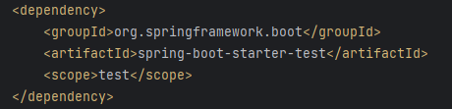
What we need?
Spring Boot dependencies for testing
By default, start.spring.io creates a Spring Boot project with the starter test dependency
This several test libraries
Junit
Mockito
Spring Test & Spring Boot Test – Utilities and integration test support for Spring Boot applications
…. and more
Notes:
Descifrare pentru http, WWW
Definitie pentru protocol – set de reguli bine definite pe care interlocutorii le urmeaza

Slide 3
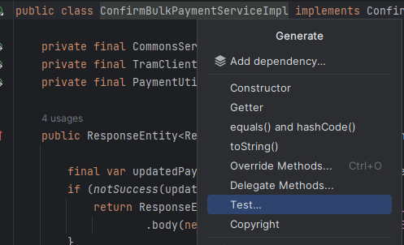
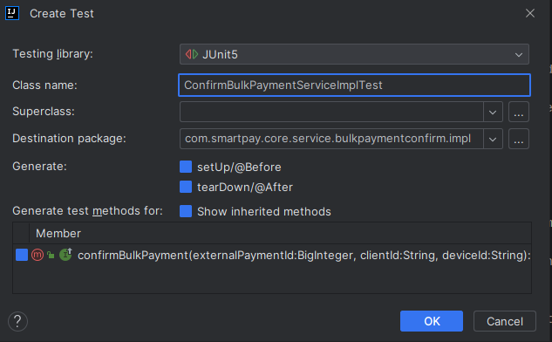
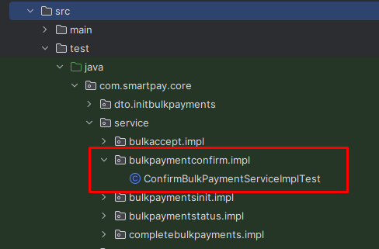
Right-click on the class name and select Generate…
Click Test...
This will generate a test class in the project’s test folder
Write JUnit tests in this class
Complete the dialog box and click OK

Slide 4
Best practices
Test small units of code
Use Mocks & Stubs
Use Test Coverage Tools (Intelij, Jacoco) ( >80% )
Test Edge Cases
Use meaningful test names (MethodName_WhenStateUnderTest_ThenExpectedBehavior, testFeatureBeingTested)
F.I.R.S.T principles of testing(Fast, Isolated, Repeatable, Self-validating, Thorough)
Don't test multiple scenarios in one test
Don’t use Spring for unit tests, if possible
Junit (without Spring) tests run very quickly
Junit tests with Spring annotations run much slower
Notes:
Test small units of code – Unit tests should focus on testing small units of code in isolation. This means that you should only test a single method or function at a time, and any dependencies should be mocked or stubbed out.
Use Mocks & Stubs - Mocks and stubs are tools used to isolate the code being tested and make it easier to test specific components in isolation. Using these tools, you can simulate the behavior of dependencies and external systems.
Use Test Coverage Tools (Intelij, Jacoco) ( >80% ) - Test coverage tools can help you determine how much of your code is being exercised by your tests. This can help you identify areas where you may need more tests to ensure full coverage.
However, a commonly recommended minimum test coverage percentage for a Spring Boot application is 80%. This means that at least 80% of the application's code should be covered by automated tests.
However, it's important to note that test coverage percentage alone does not necessarily indicate the quality of your tests. It's possible to have a high test coverage percentage but still have ineffective or poorly designed tests.
Test Edge Cases - Edge cases are inputs or conditions that are outside the normal range of expected values. Testing edge cases can help you identify unexpected behavior in your code and ensure that your application is robust and handles unexpected inputs gracefully.
Use meaningful test names – isAdult_WhenAgeLessThan18_ThenFalse, testIsNotAnAdultIfAgeLessThan18
F.I.R.S.T principles of testing(Fast, Isolated, Repeatable, Self-validating, Thorough (Complet / Minutios)) https://medium.com/@tasdikrahman/f-i-r-s-t-principles-of-testing-1a497acda8d6
Don't test multiple scenarios in one test
Don’t use Spring for unit tests, if possible (Although, Spring provides many facilities for testing, only use them when absolutely necessary)
Junit (without Spring) tests run very quickly
Junit tests with Spring annotations run much slower
Spring Boot will set up a whole Spring Boot application context, just to test one class
As the application gets bigger, with more and more managed objects, the testing will take longer

Slide 5
JUnit Annotations
@ExtendWith
@Test
@ParameterizedTest/@ValueSource
@RepeatedTest
@DisplayName
@BeforeEach/@AfterEach
@BeforeAll/@AfterAll
@Tag
@Disabled
@Timeout

Slide 6
Mockito
@Mock
@InjectMocks
@Captor
@Spy
verify()
when()
times(), never()
BDDMockito vs Mockito
given(…).willReturn(…) when().thenReturn()
then(…).should().insert(..) verify(….).insert(…)
Notes:
BDD - Behavior driven development

Slide 7
Mockito ArgumentMatchers
any()
anyString()
anyList()
isNull()

Slide 8
JUnit Assertions
assertNotNull()
assertEquals()
assertTrue()

Slide 9
Spring Integration Tests
BONUS :D
ExtendWith()
SpringBootTest
AutoConfigureMockMvc
SpyBean
MockBean

Slide 10
Useful links
Testing Best Practices for Java + Spring Apps
Testing with Spring Boot and @SpringBootTest
Mockito Tutorial
JUnit-5
JUnit-5 Assertions

Slide 11
Useful links
Testing Best Practices for Java + Spring Apps
Testing with Spring Boot and @SpringBootTest
Mockito Tutorial
JUnit-5
JUnit-5 Assertions

